Slide 1



DUNSHAUGHLIN & ROYAL GAELS
Football Pathway Plan
Planning for the Future
Runai
Mandy Griffin
Football Pathway Manager
Alan Quirke
2025

Slide 2

Our Club
Brief History
Founded in 1886, We have a boys & girls juvenile section catering for children from 5 years upwards in our nursery . GO Games cover U7 to U11 and youth football from U12 to U17.
Our club are current senior football champions in Co.Meath.
Mission Statement & Values
Our aim is to provide a fun, safe, and enjoyable sporting environment that encourages all members to reach their full potential, promote and foster individual and team excellence, and develop lifelong bonds through our strong community spirit. To be welcoming to all ages, abilities, and backgrounds.
Goals and Objectives
Participation
  Develop and implement strategies to increase participation amongst juvenile members.
Support
  Empower Coaches to deliver high-quality training and development programmes.
Safeguarding
  Ensure all activities align with GAA safeguarding policies.
Values
  Promote respect, discipline and sportsmanship amongst players, mentors and parents.
Pprogression .
  Foster a clear pathway for player and coach development within the club.

Slide 3
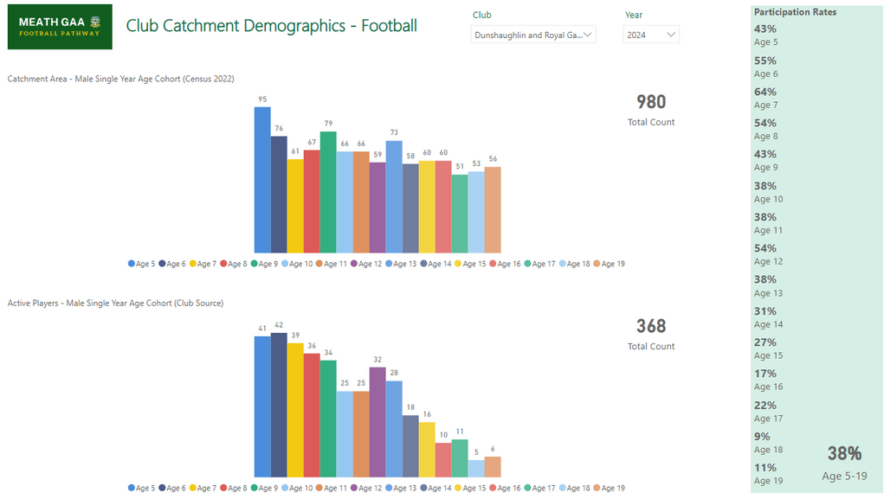
Club Catchment Demographics

Slide 4
Performance/Development/Participation Model
Performance Teams/Competition
  Preparing the team to perform to the highest level they are capable
  All players including all county players are always available
  Playing the best players available Playing players from the year below (minor only) if they are the best players Limited obligation to give game time (adult championship)
  The final result is important
Development Teams/Competition
  Exposing players to a higher standard than they have experienced before
  Giving younger/new players sustained (planned) game time no matter how they play
  Giving players returning from injury sustained game time Experimenting with positions and roles
  Exposing players to unfamiliar even uncomfortable situations
  Experimenting with tactics and game plans
  Some obligation to give game time
  The result is somewhat important, but less important than long-term development
Participation Teams/Competition
  Obligation to give everyone who commits game time
  Playing everybody that trains without exception
  Not playing players from the year below at the expense of full age players
  Not playing players from the team a grade above at the expense of other players who have not got game time
  Results are much less important than enjoyment and camaraderie
  30 mins of game time, per game, is the minimum any player should expect in a retention environment

Slide 5
Under 7 - Under 11 Football - Policies
(Go Games)
Under 7 - Under 11 | Purpose/Ethics | Development/Participation
Type of Policy | Description of Policy | Reason for Policy | Who Enforces
Coach
Games Development
Amalgamation
Streaming
Social Media
Subject to regulations to be confirmed
by Meath GAA Coaching & Games
and Coiste Go Games in early 2025

Slide 6
Under 13 Football - Policies
Under 13 | Purpose/Ethics | Development/Participation
Type of Policy | Description of Policy | Reason for Policy | Who Enforces
Coach policy | Parents encouraged to manage/coach – outside help encouraged | Unlikely to be coaches available outside parental group | CPM/Executive
Game Development Policies | Everyone who commits gets game time (Minimum of 30 minutes per game) | Retain all players/prevent exclusion/retain late developers | Coach/CPM
 | Playing 12- and 13-year-olds only, (unless short numbers on a given match day) | Retain all players/prevent exclusion/retain late developers | Coach/CPM
 | Experiment with player’s positions and roles | Improve development opportunities and game awareness for all | Coach/CPM
Amalgamation Policies | N/A
Streaming Policies | Not fully streamed – Strong players play at both first and second team level but one team may be stronger | To support the development opportunities for late developers and avoid path dependency (players stay in first or second stream) | Club Executive/CPM
 | Full age plays first team/Year two plays second team (For clubs with numbers) | To support the development opportunities for late developers and avoid path dependency (players stay in first or second stream) | CPM
Social Media Policy | No results posted/Pictures & information only | Avoid Humiliating younger players/Reduce likelihood of manager rolling back policies designed for long-term development after bad result publicised | Club PRO/County PRO

Slide 7
Under 15 Football - Policies
Under 15 | Purpose/Ethics | Development/Participation
Type of Policy | Description of Policy | Reason for Policy | Who Enforces
Coach policy | Parents encouraged to manage/coach – Getting club player/outside help involved preferred | Unlikely to be coaches available outside parental group | CPM/Executive
Game Development Policies | Obligation to give game time as per the Performance/ Development/ Participation Distribution Strategy | Retain all players/prevent exclusion/retain late developers | Coach/CPM
 | Full age players play rather than U13s | Retain all players/prevent exclusion/retain late developers | Coach/CPM
Amalgamation Policies
Streaming Policy | First and Second team streamed taking into consideration physical and athletic ability to compete at the level . There should be plenty of movement between eligible players.
Social Media Policy | Win/Loss or Draw reported only – no scores | Avoid Humiliating younger players/Reduce likelihood of manager rolling back policies designed for long-term development after bad result publicised. Players who played will know the score regardless | Club PRO/County PRO

Slide 8
Under 17 Football - Policies
Under 17 | Purpose/Ethics | Development/Participation
Type of Policy | Description of Policy | Reason for Policy | Who Enforces
Coach policy | Non Parent manage at minor level | Final decision maker not a parent, where possible in performance environment, to avoid conflict of interest | CPM/Executive
 | Parents permitted to manage in the absence of suitable candidates | Available coaches not there | CPM/Executive
Game Development Policies | Obligation to give game time (recommended 30 minutes), no matter the ability (non championship) | Retain all players/prevent exclusion/retain late developers | Coach/CPM
 | Limited obligation to give game time (championship) | Performance grade allows for full player availability | Coach/CPM
 | Capable under 15s allowed to play minor championship only | Performance grade allows for full player availability | Coach/CPM
 | No U15s play minor league unless short numbers to field a team. | Promote retention of full age players who lose out | Coach/CPM
 | No U14s up play minor | Promote retention of full age players who lose out | Coach/CPM
Streaming Policy | First and Second team streamed taking into consideration physical and athletic ability to compete at the level . There should be plenty of movement between eligible players.
Social Media Policy | Results posted across the board | Teams are better matched/Players old enough for all results to be publicised. | Club PRO/County PRO

Slide 9
Under 19 Football - Policies
Under 17 | Purpose/Ethics | Development/Participation
Type of Policy | Description of Policy | Reason for Policy | Who Enforces
Coach policy | Non Parent | Final decision maker not a parent, where possible in performance environment, to avoid conflict of interest | CPM/Executive
 | Parents permitted to manage in the absence of suitable candidates | Available coaches not there | CPM/Executive
Game Development Policies | Full age 18 & 19 Year olds prioritised for starting positions | Retain all players/prevent exclusion/retain late developers | Coach/CPM
 | Manage game time for County players/College Players | Grade is retention focused and priority for keeping players who might fall away without game time & player welfare | Coach/CPM
Amalgamation Policy
Streaming Policy | First and Second team streamed, U17s on second teams where possible |  | CPM/Executive
Social Media Policy | Results posted across the board | Teams are better matched/Players old enough for all results to be publicised. | Club PRO/County PRO

Slide 10
Resources
Annual Coaching Plan
The Club Football Pathway Plan includes an Annual Coaching Plan for all Child & Youth age groups in the Club. Individual Club Team Planning templates will be available to all teams in the Club to assist coaches with planning their coaching content for the season.
Club Coaching Session plans which cover Technical, Tactical and Physical content are available to all Club coaches to use with their teams during the year.
Club Football Pathway Workshops and Coaching support sessions will be provided to the Club by the Meath GAA Games Development Coordinator for the region during the season. These workshops and support visits will assist with Coach development and align what we are coaching at all age groups in the Club.
The Club Football Pathway Manager will be responsible for assisting coaches putting in place annualised age specific coaching plans for each team in the Club.
These Annual Coaching Plans will support the retention of underage Club players to continue to play for the Club and, ultimately, play adult Club competition.

Slide 11
Resources
Annual Athletic Development Plan
The vision for 2025 is that our Club will be better equipped to integrate athletic development within our current underage training practices.
To support this vision and to better support our young players, the Meath GAA Academy Head of Athletic Development will deliver ‘Athletic Development Level 1 (F3 Youth)’ coach education courses across the year. The course aim is to ‘Champion the Volunteer Coach’ and was developed by the Gaelic games Sports Science Working Group’s Athletic Development sub-group.
Alongside this coach development initiative, the Academy Head of Athletic Development will support and help to develop our Club Football Pathway Plan via the provision of additional athletic development resources and supports which will be available through the Teambuildr platform
This ongoing support and guidance will be available to our to Club Pathway Manager and Club coaches to ensure that our club can deliver athletic development as efficiently and effectively as possible.

Slide 12
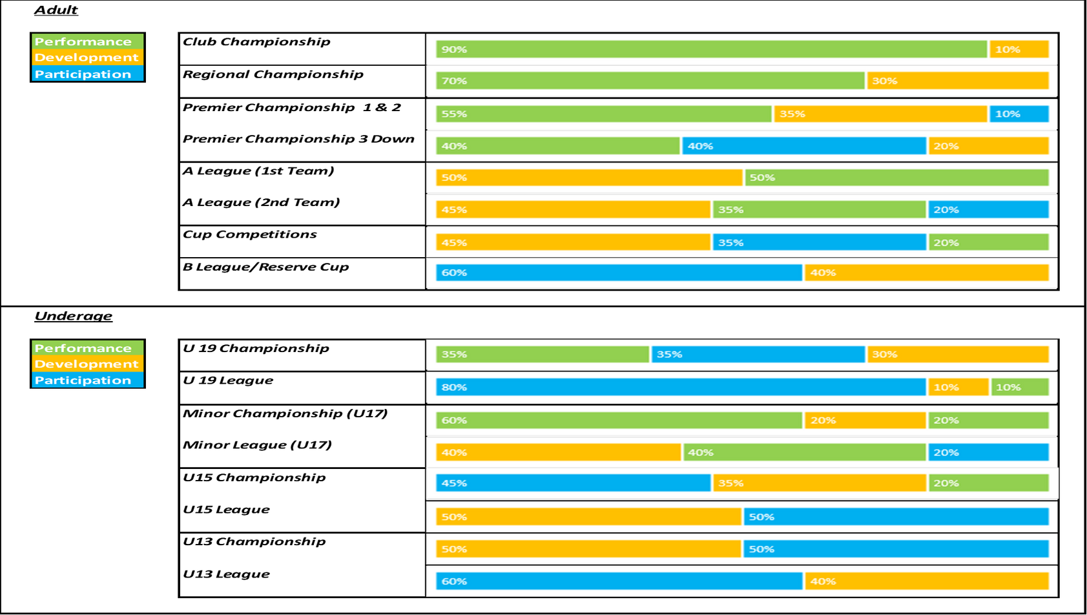
COMPETITION ETHOS

Slide 13
Team Performance/Development/Participation Distribution Strategy
Team & Competition | Performance | Development | Participation
U19 Championship | 90% Performance | 10% Development | 0% Participation
U19 League | 33% Performance | 33% Development | 33% Participation
U17 Minor Championship | 50% Performance | 40% Development | 10% Participation
U17 Minor League | 40% Performance | 40% Development | 20% Participation
U15 Championship | 40% Performance | 50% Development | 10% Participation
U15 Grading League | 10% Performance | 40% Development | 50% Participation
U13 Autumn League | 0% Performance | 50% Development | 50% Participation
U13 Spring League | 0% Performance | 50% Development | 50% Participation

Slide 14

Contacts
Club Football Pathway Manager –Alan Quirke
  Tel: 087 8126036
  Email: alan.quirke@phasor.ie
Club Coaching Officer – Marty Reilly
  Tel: 087 4129230
  Email: martin@minnis.ie
Club Juvenile Chairman –Marc Leddy
  Tel: 087 9144015
  Email: mleddy90@gmail.com
Club Juvenile Secretary –Mandy Griffin
  Tel: 086 7276660
  Email: Secretarybng.dunshaughlin..meath@gaa.ie
Under 13 Football Coach –Owen McGrath
  Tel: 087 1230624
  Email: otcmcgrath@yahoo.com
Under 15 Football Coaches –Alan Quirke& Paudie Herlihy
  Tel: 087 8126036 / 086 8166693
  Email: alan.quirke@phasor.ie / padraigherlihy@gmail.com
Under 17 Football Coach – Aiden Kealy
  Tel: 086 2668564
  Email: aiden@kealyconstruction.ie
Under 19 Football Coach –Aiden Kealy
  Tel: 086 2668564
  Email: aiden@kealyconstruction.ie
The policies outlined in this Plan were adopted by the Club Executive Committee and/or AGM, February 2025.
This Club Football Pathway Plan was produced in association with Meath GAA Coaching & Games and the Meath Football Development Committee

